Slide 1
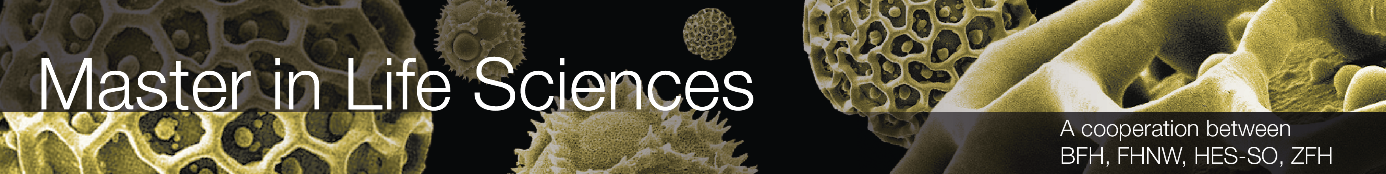
Presentation of day 5
By group 3:
Näf Adrian, Pesen Pelin, Polini Elisa, Schürch Stefanie, Späne Philipp, Genilloud Franck, Lemus Rodriguez Jony Alejandro, Nicollier Alexandre, Noël Jérémie, Pantelidis Alexandros, Khan Salman Khan, Kölbener Christa, Kreuzer Jan, Kuleta Natalia Karolina, Lopez Sosa Alejandra, Memeti Nurdzane, Zuković Dženneta, Müller Benjamin, Nedic Maja, Xaaji Yusuf
BP3 Design of Biopharmaceutical Production Facilities

Slide 2
Introduction
Conceptual design of a Biopharmaceutical production facility
Following the cGMP requirements of Switzerland and the USA
Prioritising SU systems
A total of 72 batches
Product | Amount [kg/year] | Titer [g/l] | Yield | Number of Batches
A | 100 | 4 | 0.684 | 19
B | 70 | 3 | 0.706 | 17
C | 70 | 2 | 0.64 | 28
D | 40 | 4 | 0.64 | 8

Slide 3
Area Schedule
Area | Room | Equipment | BSL | Hygienic zone | Level | Area [m2] | Room height [m] | Room volume [m3] | Air exchange rate [m3/h]
Utilities/Facility Man | HVAC | Heater, Cooler, Humidifier, Multi Filters (HEPA), Compressor, Ventilators, Mixing Chambers | - | - | 2nd floor
Utilities | ambient Heating & Cooling | General Hot Water System & electrical coolers |  |  | 2nd floor
Utilities | Waste treatment | Autoclave, Storage space Warehouse, | - | - | Basement
Utilities | Portable Water and Purified Water | Tank FW, 2 x Tank PW, Heat Exchanger, Reverse Osmosis, Nanofiltration, 2 Pumps |  |  | Basement
Utilities | WFI/Steam Production | 2 x WFI Tank, Heat Exchanger, Multi Step Destillation Column (WFI), Distillation Column (Clean Steam), compressor | - | - | Basement
Utilities | Clean compressed Air | Compressor, Storage, Valves, Filters & Deoiling |  |  | Outside
Utilities | Process Gases | Storage for N2, O2, CO2, H2O2, Liquid Nitrogen + pneumatic valves for all, | - | - | Outside
Utilities | Emergency Generators |  | - | - | Basement
Media | Medium preparation | 1000L tank, 2000L tank |  | D | Ground floor | 37 | 3 | 109.5
Media | Medium cold storage |  |  | D | Ground floor | 32 | 3 | 95.9
Media | Buffer preparation | 50L, 100L, 500L, 1000L, 1500L, 2000L, 3000L tanks |  | D | Ground floor | 192 | 3 | 575.4
Media | Buffer cold storage |  |  | D | Ground floor | 124 | 3 | 372.7
USP | Personnel Airlock Inoculation Lab |  | 1 | C | Ground floor | 5.76 | 3 | 17.3
USP | Inoculum Production lab | Freezer -80°C, laminar flow hood, microscope incubator, NucleoCounter | 1 | C | Ground floor | 19.74 | 3 | 119.2
USP | Cell expansion, Production | 20L Wave , 200L STR (SU), 2000 STR (SU) bioreactors, Autoclave | 1 | D | Ground floor | 144.72 | 3 | 434.2
USP | Personnel Airlock Men USP |  | 1 | C | Ground floor | 32.7 | 4 | 98.1
USP | Material Airlock USP |  | - | C | Ground floor | 14.21 | 3 | 42.6
USP | Harvest | Depth filter, Pump | - | D | Ground floor | 30.42 | 3 | 91.3
USP | Corridor |  | - | D | Ground floor | 77.64 | 3 | 230.4
DSP | Personnel Airlock Personal USP QC-DSP V+ |  | - | C | Ground floor | 33 | 3 | 98.1
DSP | Personnel Airlock women DSP V+ |  | - | C | Ground floor
DSP | Personnel Airlock DSP virus-freezing D |  | - | C | Ground floor
DSP | Personnel Airlock DSP virus-freezing CNC |  | - | D | Ground floor
DSP | Material Airlock USP QC-DSP V+ |  | - | C | Ground floor
DSP | Material Airlock Buffer storage-DSP V+ |  | - | C | Ground floor
DSP | Material Airlock Buffer storage-DSP V+/- |  | - | C | Ground floor
DSP | Material Airlock DSP V- - Freezing |  | - | C | Ground floor
DSP | Material Airlock DSP V- - Freezing |  | - | D | Ground floor
DSP | DSP room V+ | See DSP list | - | C | Ground floor | 223 | 3 | 669.2
DSP | DSP room V- | See DSP list | - | C | Ground floor | 65 | 3 | 193.9
DSP | DSP freezing room |  | - | CNC | Ground floor | 29 | 3 | 87.3
DSP | DSP storage room |  | - | CNC | Ground floor | 23 | 3 | 68.4
Warehouse | Warehouse |  |  | -
Raw material lab | Raw material lab |  | - | -
Facility Management | Reception |  | - | -
Facility Management | Offices |  | - | -
Facility Management | Cafeteria |  | - | -
Facility Management | Toilets Men |  | - | -
Facility Management | Toilets Women |  | - | -
Facility Management | Stairs |  | - | -
Facility Management | Elevator |  | - | -
Facility Management | Data Storage |  | - | - | Basement

Slide 4
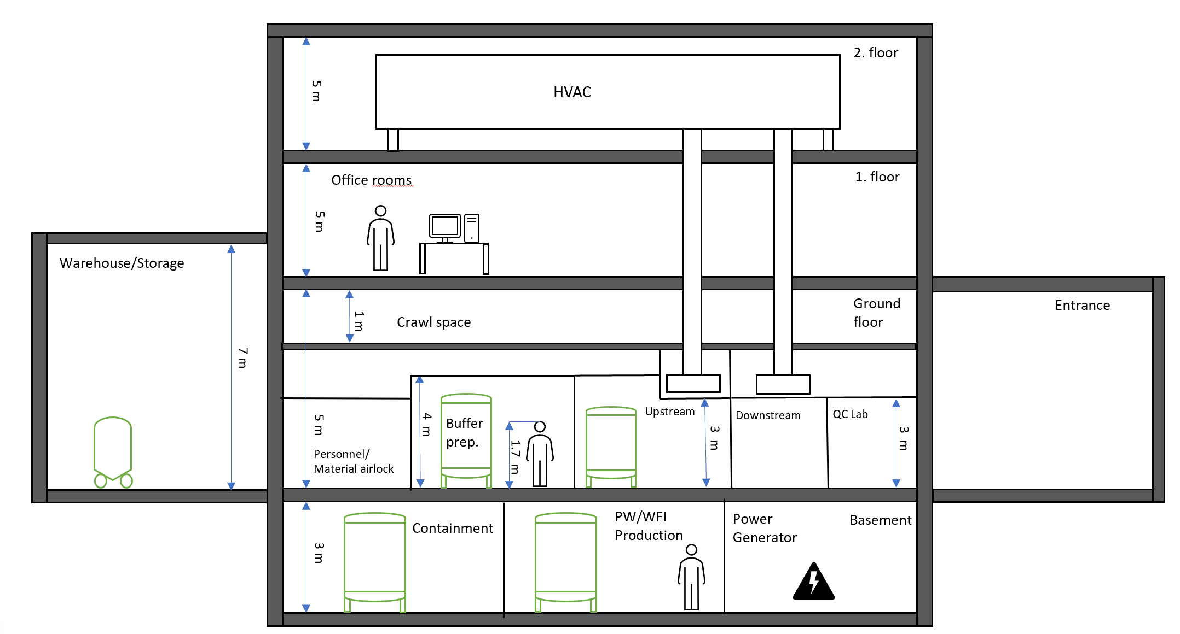
Height concept
Notes:
Building with 4 floors
Production takes place on the ground floor
Small crawl space for ventilation
Height was adjusted according to the tallest device in the respective area
On the first floor there is room for offices
Second floor is for the whole HVAC plan ---→ has enough space for maintance
On the side of the building is a Warehouse for storage of materials
Warehouse is 7 meters high
In the basemant the containmant plant as well as the WFI-plant is located for the production and waste management
Additionally there are power and emergency generator located in the basement
This is in case of a power outage

Slide 5
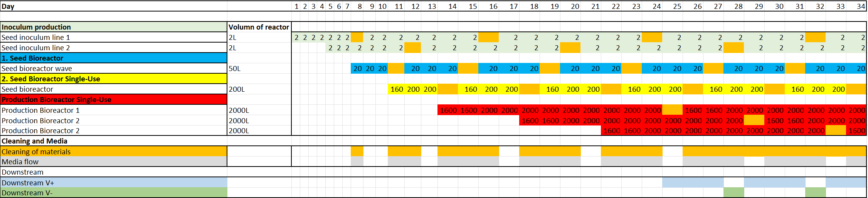
Occupancy list
Notes:
We have 72 batches which must be made in a year
Plant should operate for 320 days in a year
After some calculations we choose
Staggered process with 2 inoculum seed lines and 3 production bioreactors
Production with all bioreactors is reached on day 22
Off time of the process-step is marked orange
At this time cleaning and replacement will take place of the respective material

Slide 6
Progress USP-Team

Slide 7
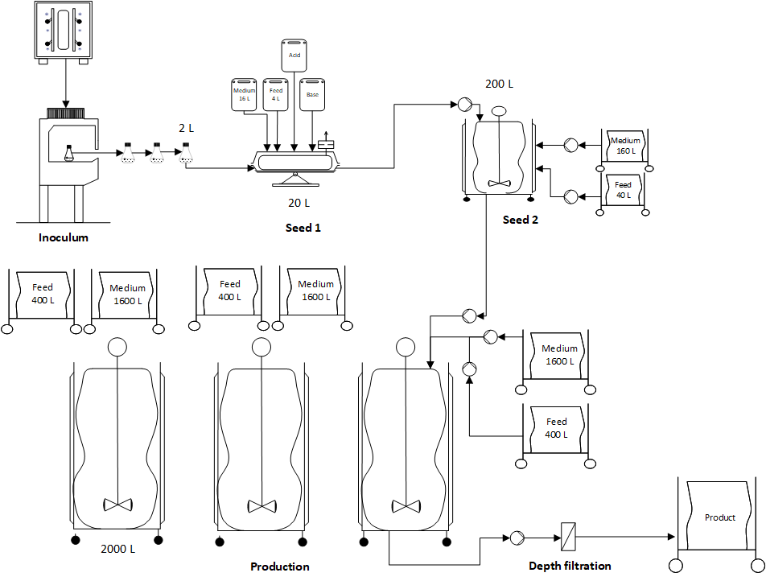
Plant on a Page - USP

Slide 8
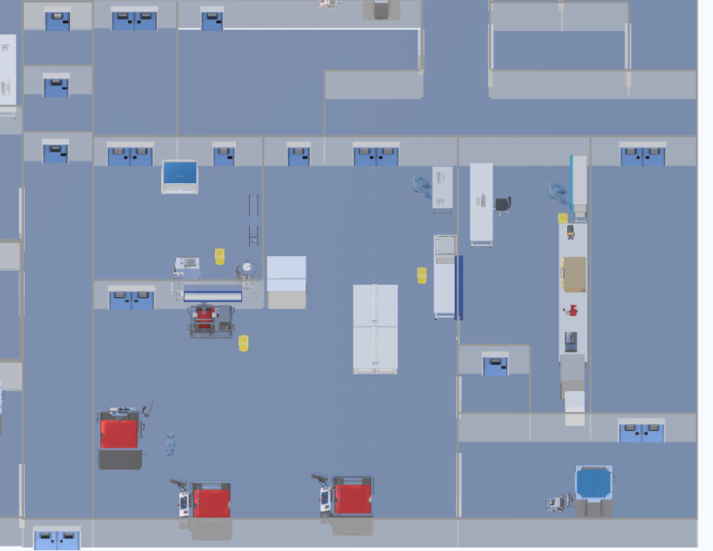
HakoBio USP
4
1
2
3

Slide 9
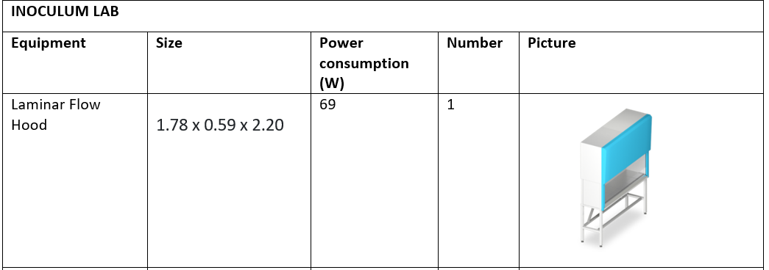
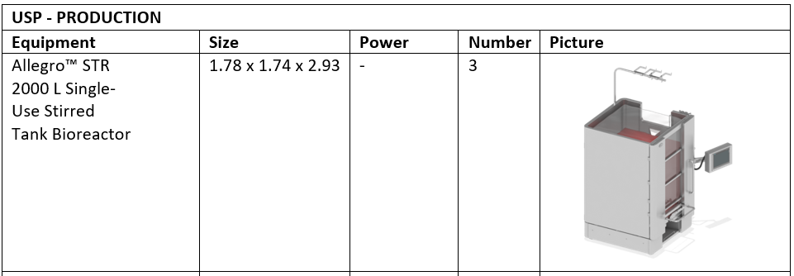
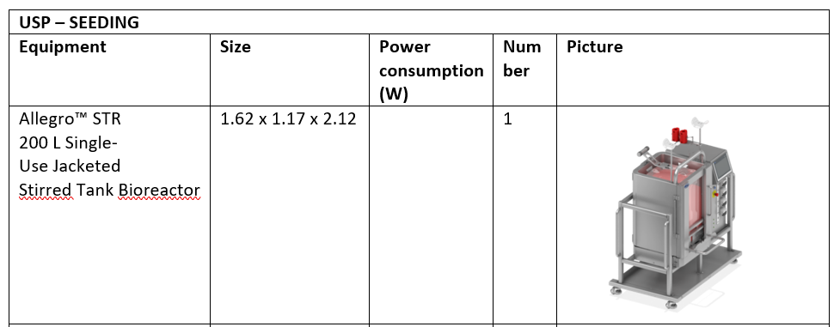
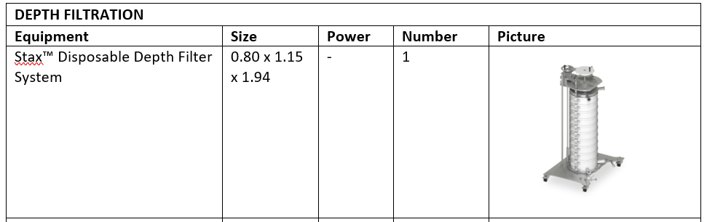
Size and functions of USP systems

Slide 10
Progress DSP-Team

Slide 11
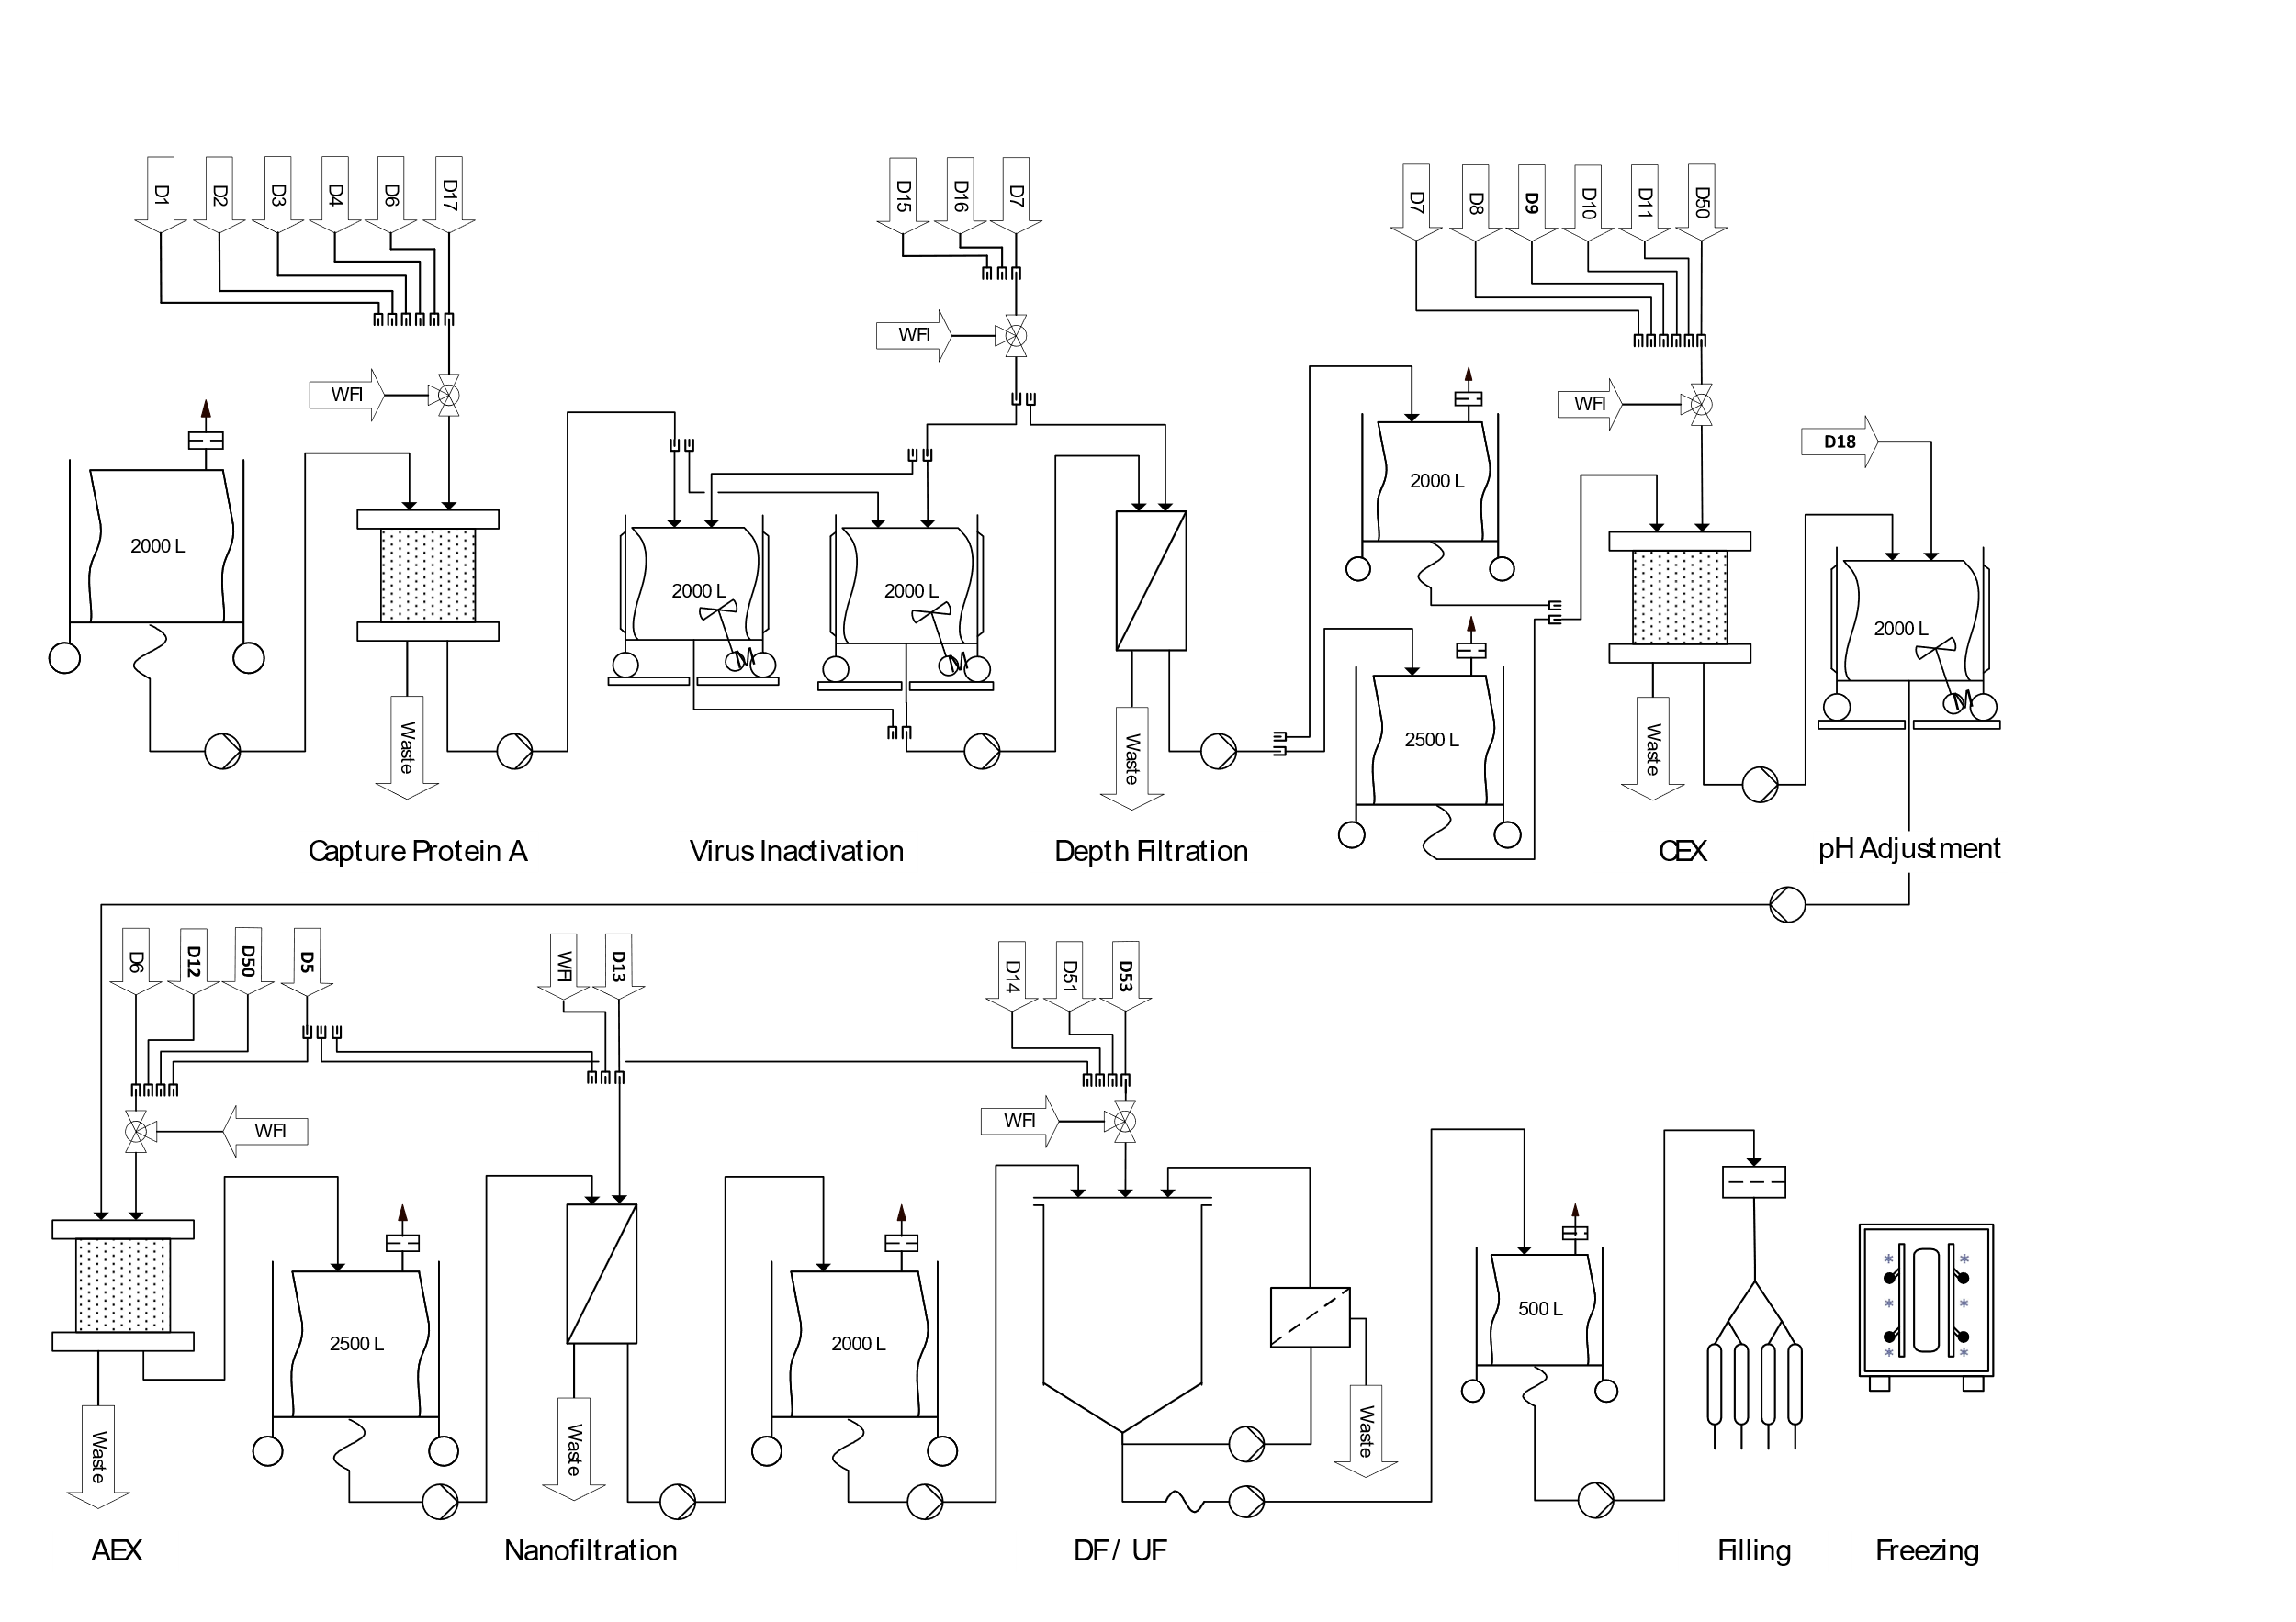
Plant on a Page - DSP

Slide 12
Plant on a Page - DSP

Slide 13

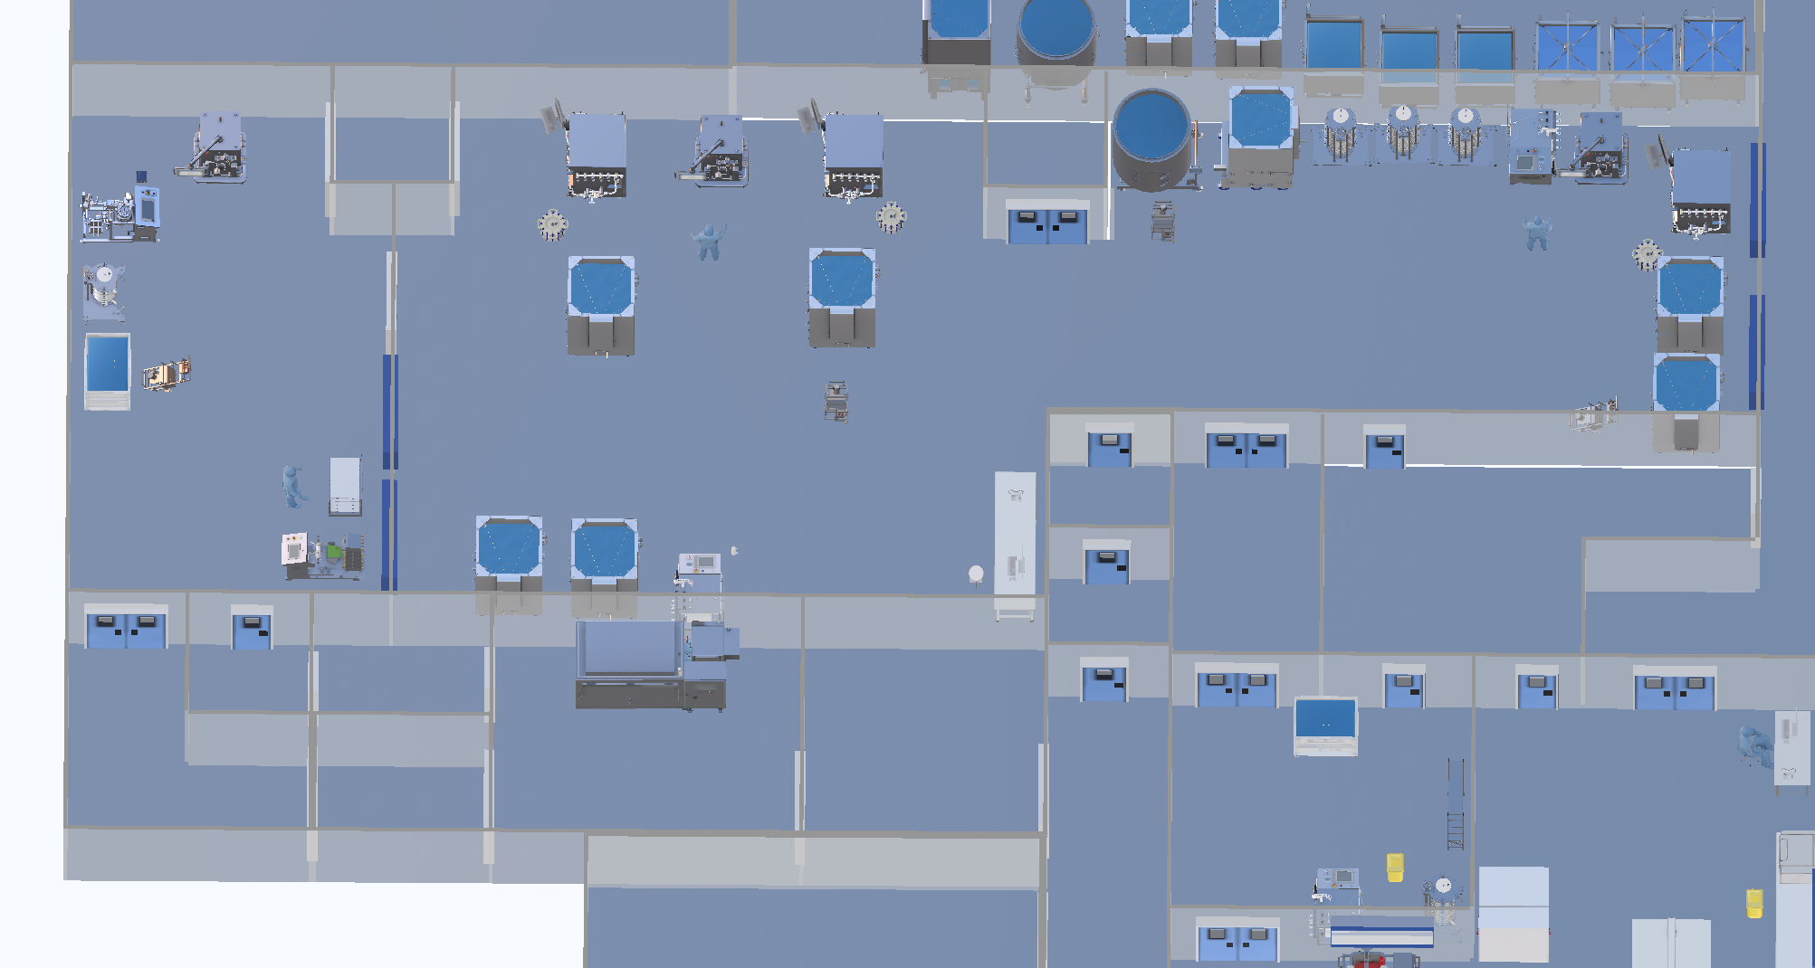


HakoBio DSP
5
4
9
6
2
12
13
10
7
3
1
14
8
11
15
16

Slide 14
Size and functions of DSP systems – DSP V+
Buffer Management:
Protein A Capture, CIEX, AIEX:

Slide 15
Size and functions of DSP systems – DSP V+
Virus inactivation (pH-shift) pH adjustment
Nanofiltration
Combined with the MVP:
Depth filtration filter
Nanofiltration capsule

Slide 16
Size and functions of DSP systems – DSP V-
Diafiltration/ Ultrafiltration ((UF/DF)
Combined with the MVP:
0.2 µm filtration (Depth End Filtration)
Bulk filling
Bulk freezing

Slide 17
Progress Media- and Buffer-prep Team

Slide 18
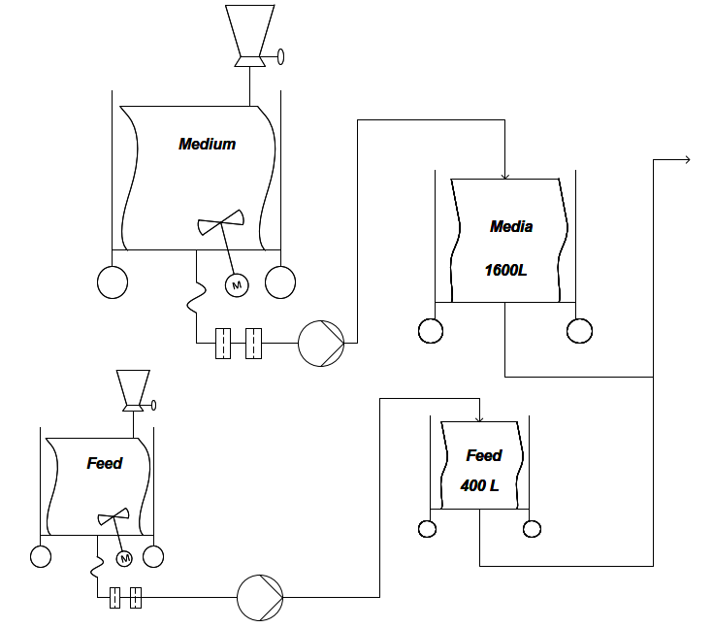
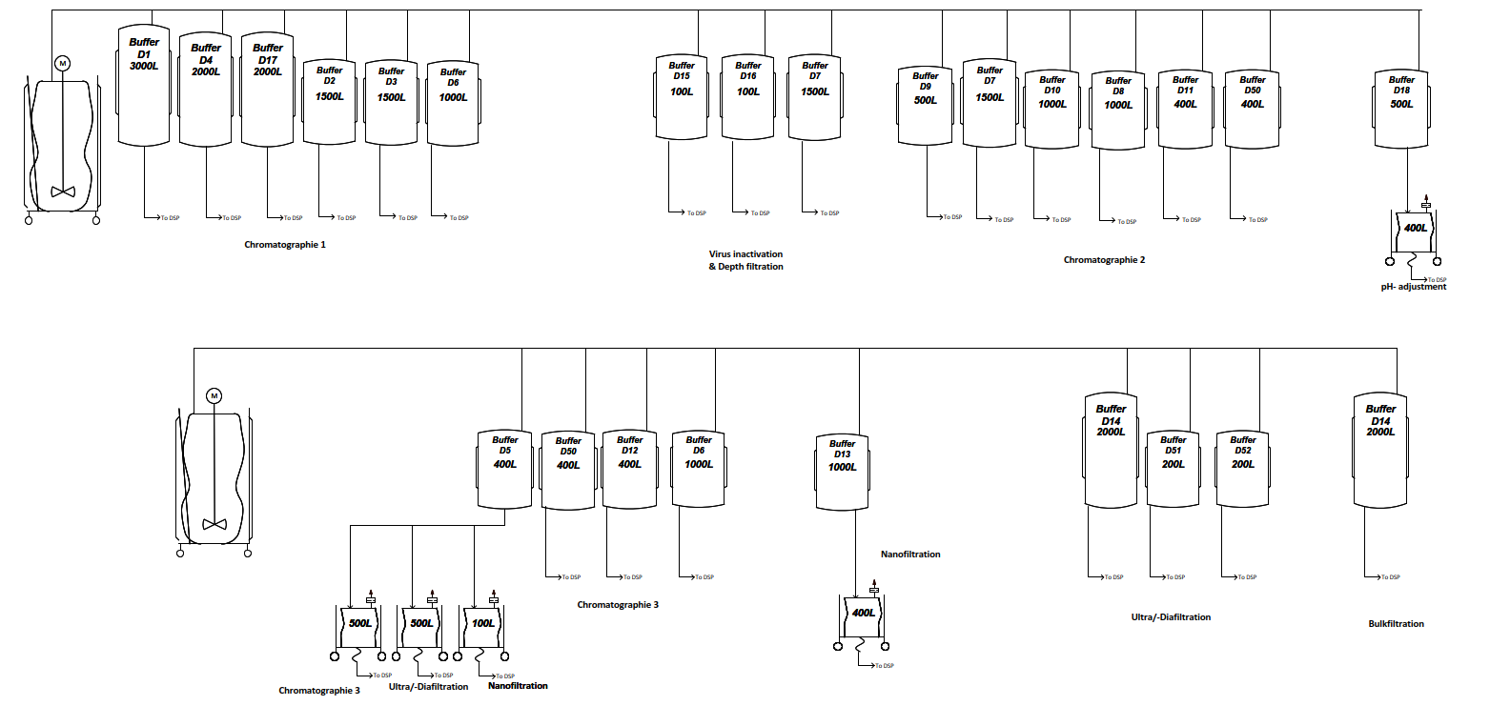
Plant on a Page - Media and Buffer preparation
[1] Media preparation
[2] Buffer preparation

Slide 19
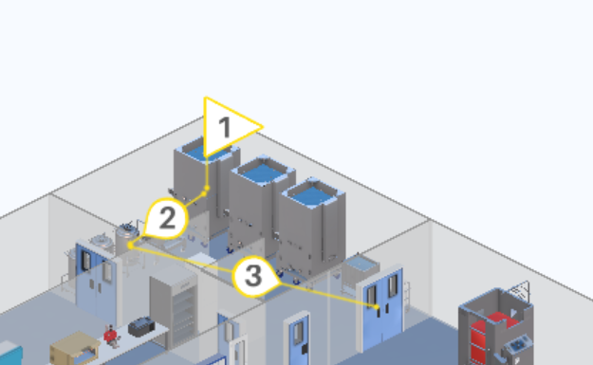
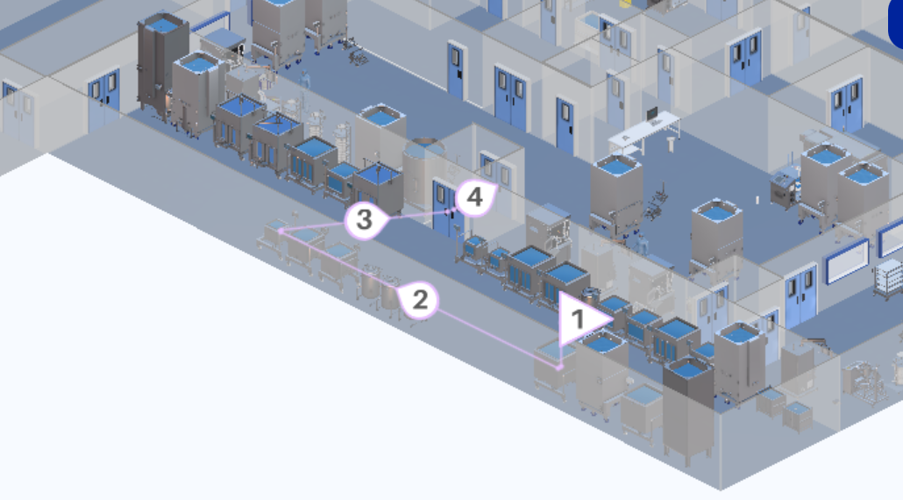
HakoBio- Media and Buffer preparation

Slide 20
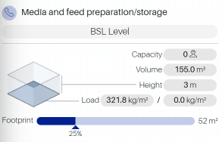
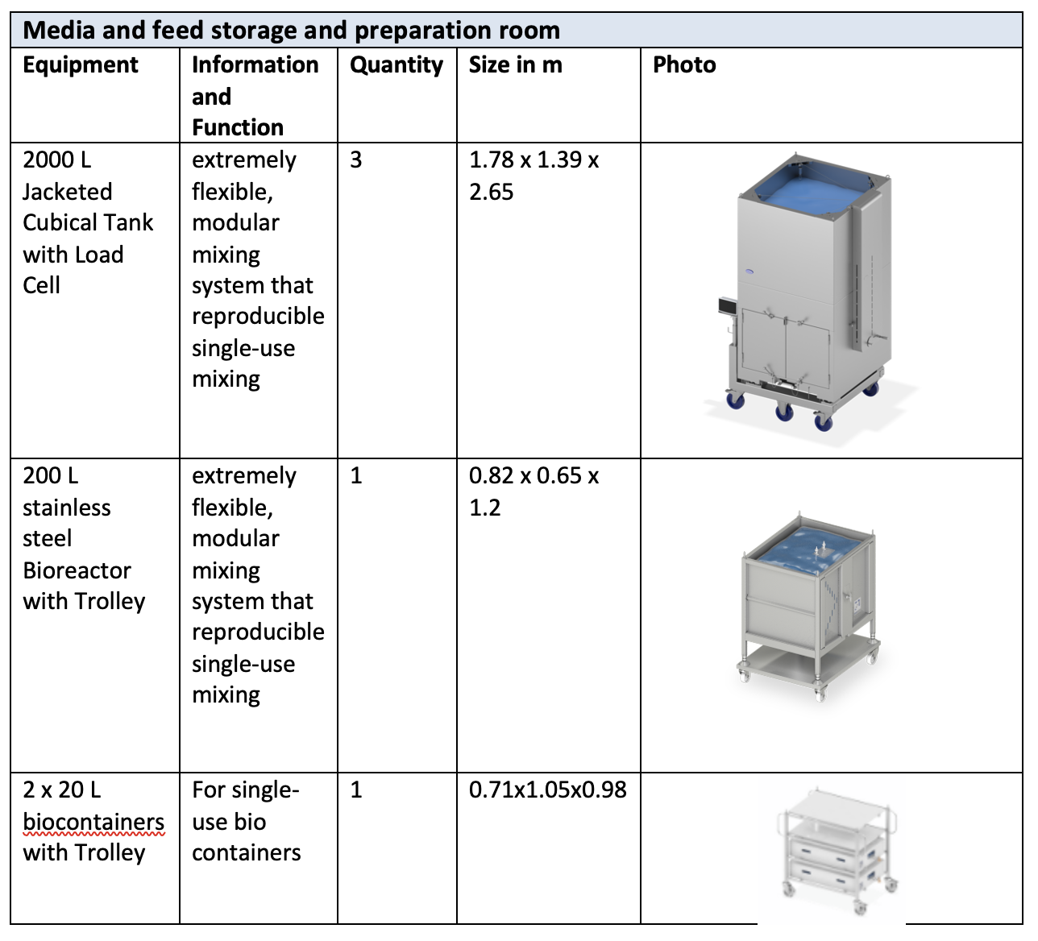
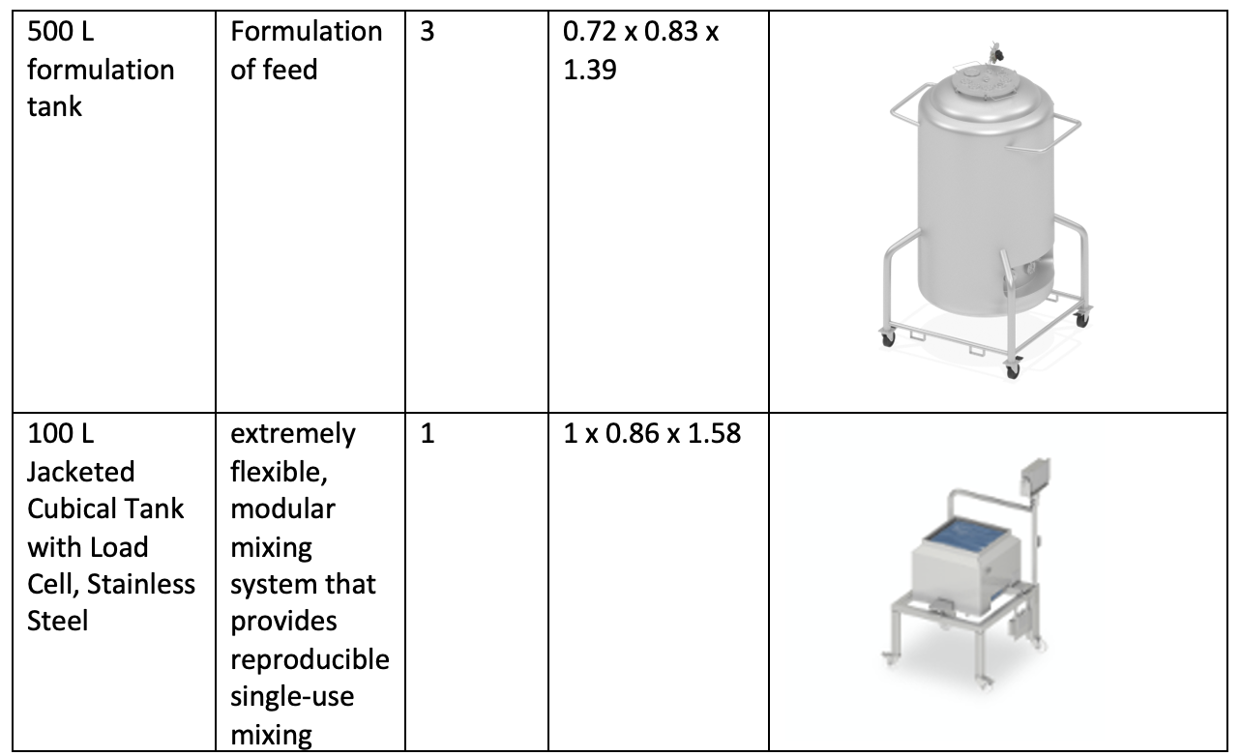
Size and functions -Preparation of media

Slide 21
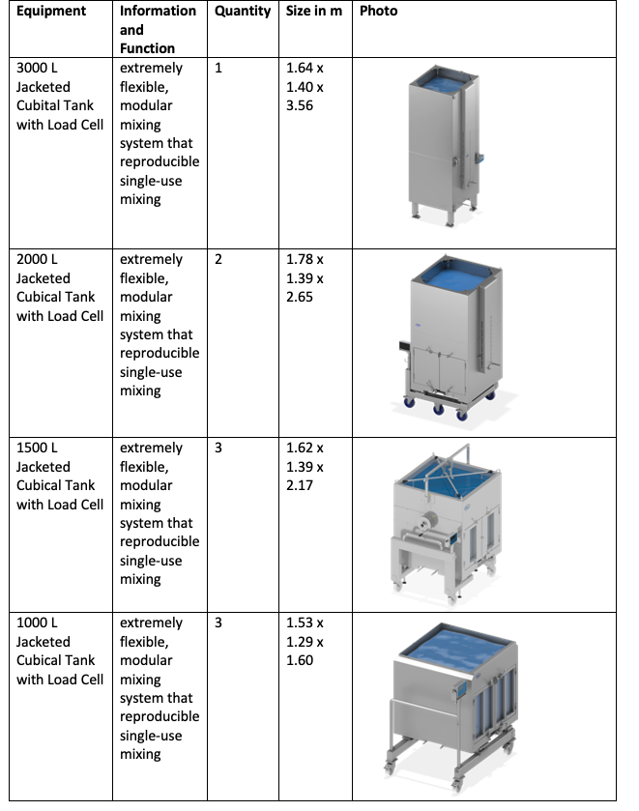
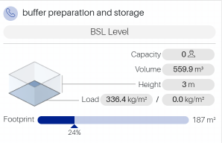
Size and functions - Preparation of buffer

Slide 22
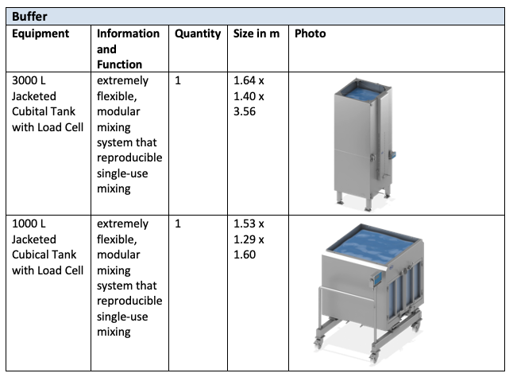
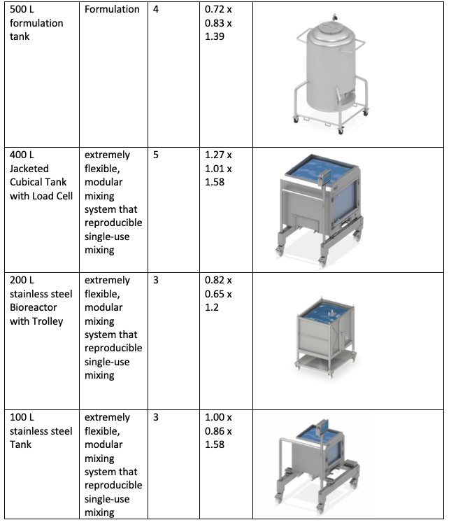
Size and functions - Storage of buffer

Slide 23
Progress Utility-Team

Slide 24
Clean Utilities
 | WFI Volume per batch [L] | PW Volume per batch [L] | Solid Waste Volume per batch [L] | Liquid Waste Volume per batch [L] | Liquid Biological Waste per batch [L]
DSP | 3541 | - | 625 | 42000 | -
USP | - | 2500 | - | - | 2500

Slide 25
Equipments Clean Utilities
PW | WFI | Clean Steam | Clean Compressed air | Process Air (HVAC) | Process Gases (N₂, O₂, CO₂₎ | Liquid Nitrogen
Basement | Basement | Basement | Basement | 2.nd Floor | Outside | Outside
Heat exchanger | Heat exchanger | Distillation Column | Filters | Filters | Storage Tanks for all gases | Storage Tank
Storage Tank | Storage Tank | Compressor | Pneumatic Valve | Cooler | Pneumatic Valve | Pneumatic Valve
Reverse Osmosis | Distillation Column |  | Storage | Heater + Reheaters
Nano Filtration |  |  | Compressor | Humidifier
Water Treatment |  |  |  | Mixing Chambers
Notes:
We did a list of the main equiptment used for the clean utilities

Slide 26
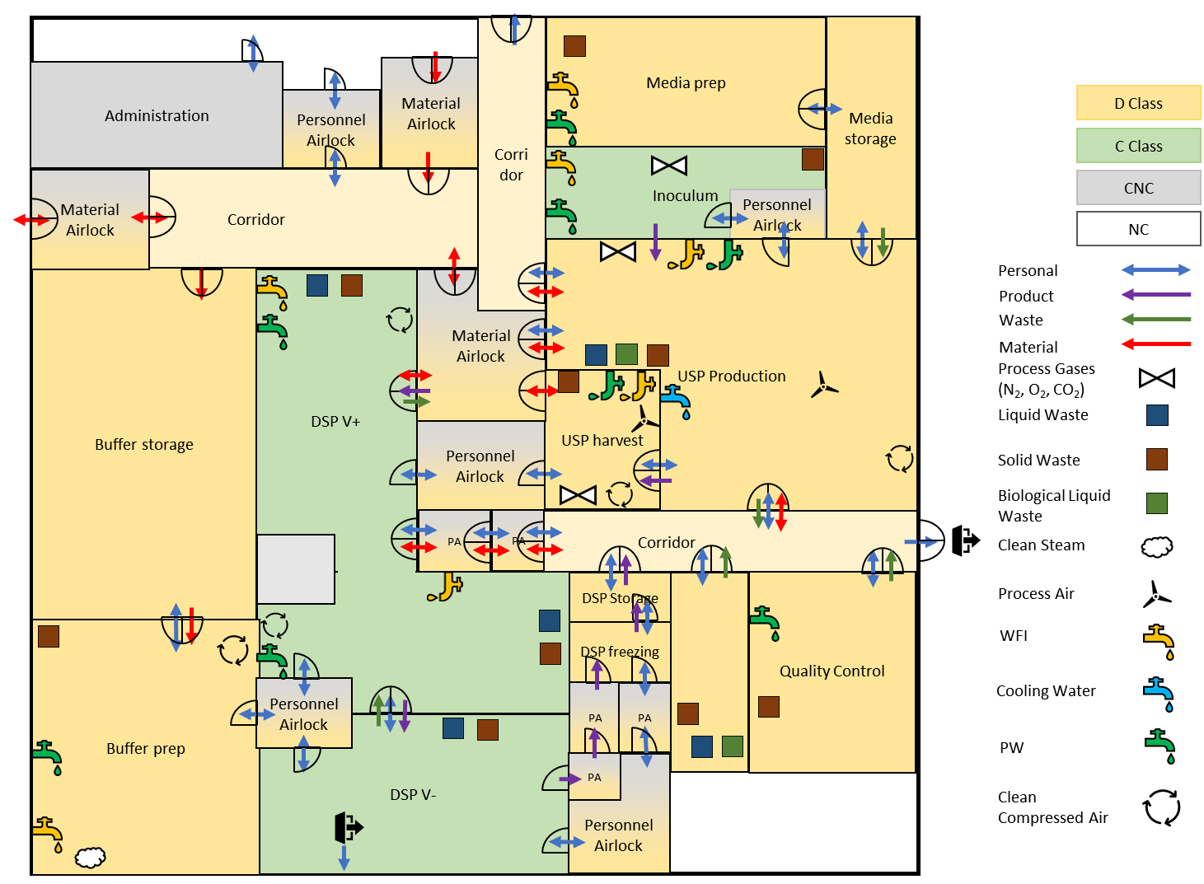
HVAC And Points Of Use Zone Concept
Notes:
Not final, as Zone concept changed today

Slide 27
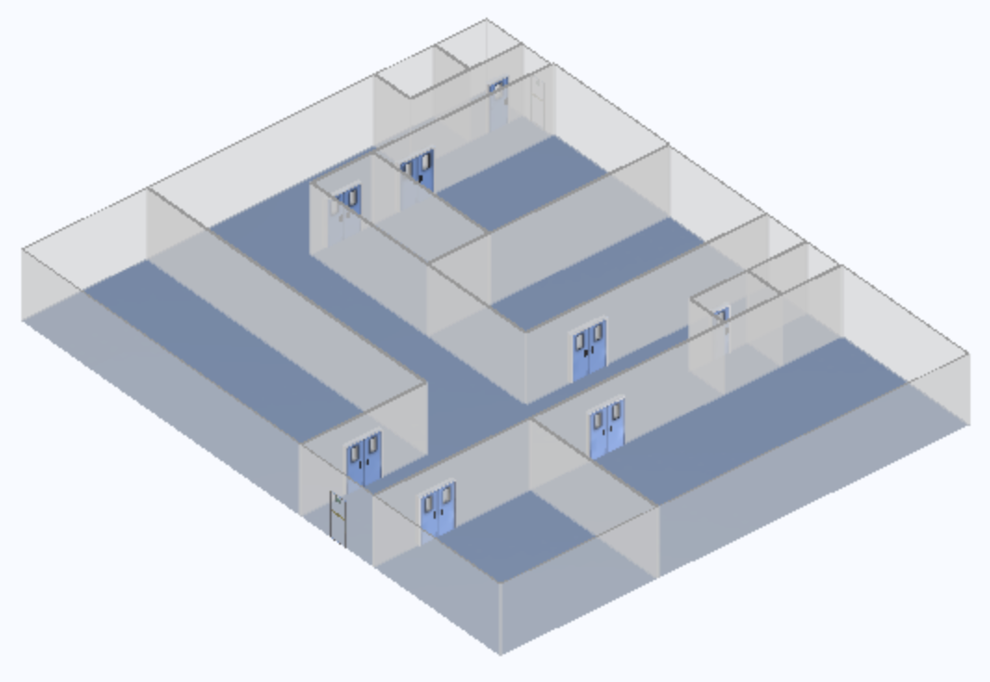
HakoBio - Basement zone concept

Slide 28
Points Of Uses

Slide 29
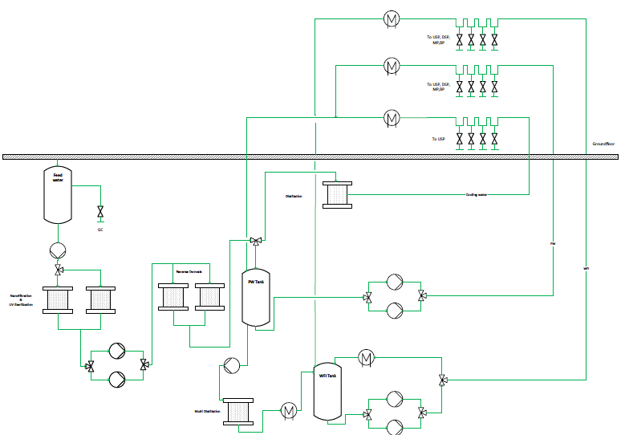
WFI & PW and
Clean Steam System

Slide 30
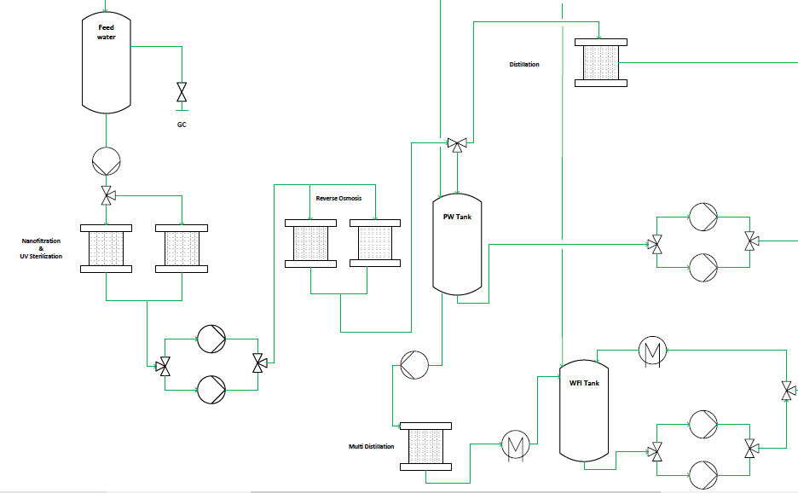
Notes:
Valve missing, probennahme

Slide 31
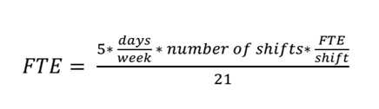
Staff estimation

Slide 32
Feedback
What we liked:
very interactive course
interesting inputs from various experts
feeling of a "small company”
students with diverse expertise and experience follow one goal
one gets a sense of collaboration with different people having different interests
Suggestions for improvement:
Course structure
Instead of long intros from companies, more direct help
feedbacks on progress
more detailed explanation of the different tasks
Assignment to management: own initiative
HakoBio
difficult to collaborate between the groups
saving was not always possible
energy consuming and slow
Visio
introductory video/slide/lesson at the beginning of the course
few had access or experience with the program

Slide 33
Do you have any questions ?

